Slide 1
EART30351
Lecture 6

Slide 2
Reminder – the momentum equation
We saw last time that the momentum equation in a frame of reference fixed to the Earth is:
where V is the 3-D wind vector. When transformed to a local frame of reference it looks very similar. The horizontal components of this equation can be expressed in terms of U = (u,v,0), the 2-D horizontal velocity vector:
where where A is the radius of the Earth, k is a unit vertical vector and f = 2Ωsinλ = 1.46 x 10⁻⁴ sinλ s⁻¹
We convert between material (Lagrangian) and local (Eulerian) derivatives using:

Slide 3
In component form the full equations are:

Slide 4
Scale analysis
For the synoptic-scale motions that we are interested in
Horizontal scale L ~ 10⁶ m
Vertical scale D ~ 10⁴ m
Time scale T ~ 10⁵ s
Typical horizontal wind U ~ 10 ms⁻¹
Typical vertical wind w~ 0.01 ms⁻¹
Pressure p ~ 10⁵ Pa (1000 mb)
Typical pressure excursion Δp ~ 30 mb = 3000 Pa horizontally
Surface air density ρ ~ 1 kg m⁻³
Radius of Earth A ~ 10⁷ m
Earth rotation rate Ω ~ 10⁻⁴ s⁻¹

Slide 5
Scale analysis: vertical momentum equation
Horizontal scale L ~ 10⁶ m
Vertical scale D ~ 10⁴ m
Time scale T ~ 10⁵ s
Typical horizontal wind U ~ 10 ms⁻¹
Typical vertical wind w~ 0.01 ms⁻¹
Pressure p ~ 10⁵ Pa (1000 mb)
Typical pressure excursion Δp ~ 30 mb = 3000 Pa horizontally
Surface air density ρ ~ 1 kg m⁻³
Radius of Earth R_{E} ~ 10⁷ m
Earth rotation rate Ω ~ 10⁻⁴ s⁻¹
W/T p/D g U²/A ΩU
10⁻⁷ 10 10 10⁻⁵ 10⁻³

Slide 6
Balance in the vertical
The pressure gradient and gravitational accelerations are much bigger than the other terms. Therefore they must be closely in balance:
$$\frac{1}{ρ}\frac{∂p}{∂z}+g=0 ⇒ \frac{∂p}{∂z}=−ρg$$
This is hydrostatic balance, as we met in lecture 1: hydrostatic balance holds when vertical acceleration << g, which is only violated on small scales e.g. vigorous thunderstorms

Slide 7
Scale analysis: horizontal momentum equation
Horizontal scale L ~ 10⁶ m
Vertical scale D ~ 10⁴ m
Time scale T ~ 10⁵ s
Typical horizontal wind U ~ 10 ms⁻¹
Typical vertical wind w~ 0.01 ms⁻¹
Pressure p ~ 10⁵ Pa (1000 mb)
Typical pressure excursion Δp ~ 30 mb = 3000 Pa horizontally
Surface air density ρ ~ 1 kg m⁻³
Radius of Earth R_{E} ~ 10⁷ m
Earth rotation rate Ω ~ 10⁻⁴ s⁻¹
U/T Δp/Lρ fU U²/A
10⁻⁴ 10⁻³ 10⁻³ 10⁻⁵

Slide 8
Geostrophic balance
In the horizontal, the pressure gradient and Coriolis accelerations are the leading terms:
$$−\frac{1}{ρ}∇p−fk×U=0$$
Unlike hydrostatic balance, this is only approximately valid and departures from geostrophy are of crucial importance in atmospheric dynamics.
We define a geostrophic wind from this equation as the wind found when the atmosphere is in balance:
$fk×U_{g}=−\frac{1}{ρ}∇p$; use k x k x U = -U
$U_{g}$ = $\frac{1}{ρf}k×∇p$
pressuregradientaccn
U_{g}
Low pressure
Coriolis
∇p
High pressure

Slide 9
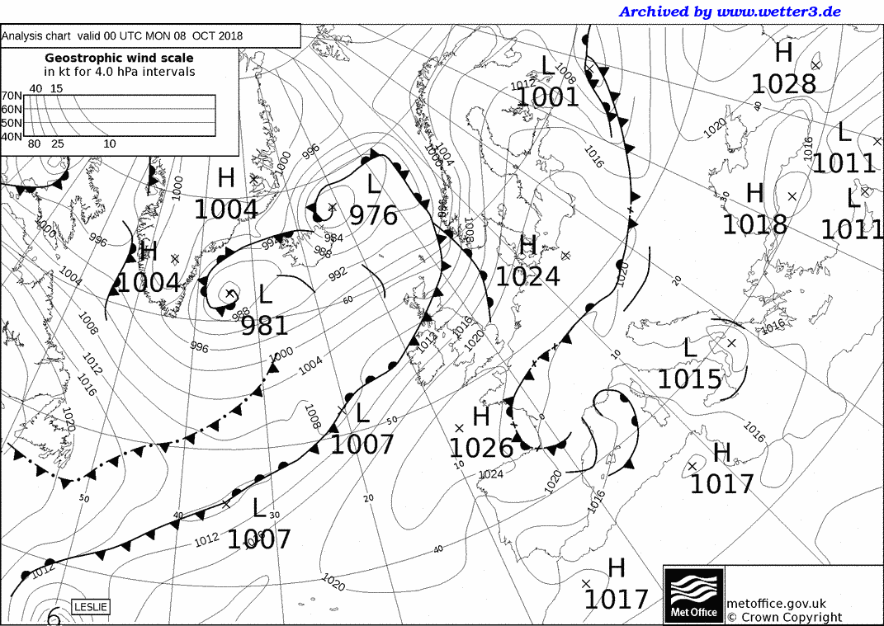
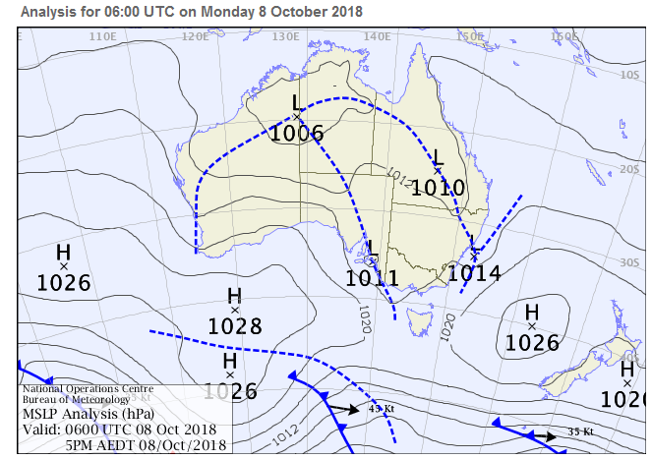
Geostrophy
Northern Hemisphere
Southern Hemisphere
Anticlockwise around a low pressure – cyclonic
Clockwise round a high pressure - anticyclonic
Clockwise around a low pressure – cyclonic
Anticlockwise round a high pressure - anticyclonic

Slide 10

Effect of friction
$$−\frac{1}{ρ}∇p−fk×U−F=0$$
Wind flows across isobars towards low pressure
Triangle of forces (accelerations):
F is much larger over land than over ocean – so surface winds depart strongly from geostrophic over land
Winds at sea are stronger and aligned along the isobars
Pressure gradient accn
U
Co
pgf
F
Coriolis
Friction

Slide 11
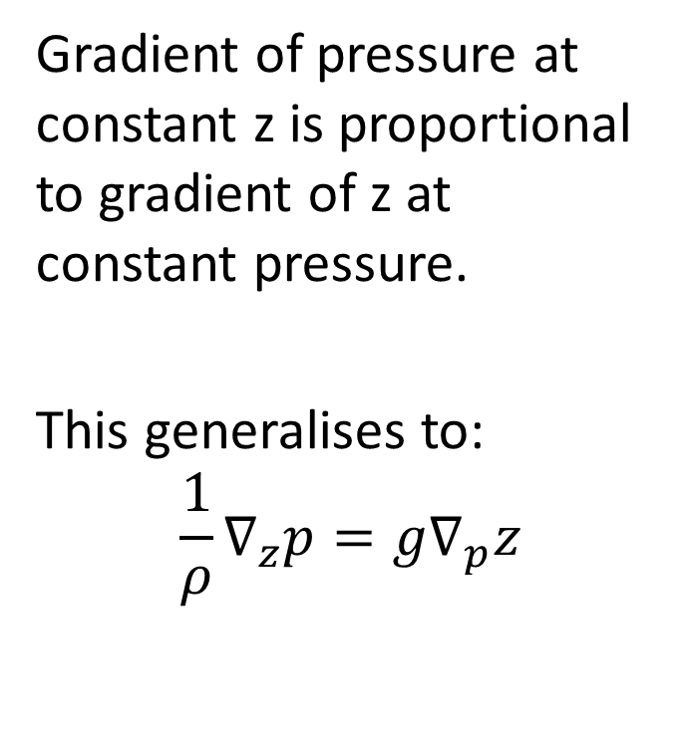
Pressure coordinates
Use hydrostatic equation to remove density from momentum equation
From the mathematical identity:
${\left.\frac{∂p}{∂x}\right|}_{z}$. ${\left.\frac{∂z}{∂p}\right|}_{x}$. ${\left.\frac{∂x}{∂z}\right|}_{p}$= -1
$${\left.\frac{∂p}{∂x}\right|}_{z}=−{{\left.\frac{∂p}{∂z}\right|}_{x}\left.\frac{∂z}{ ∂x}\right|}_{p}{\left.=ρg\frac{∂z}{∂x}\right|}_{p}$$
Gradient of pressure at constant z is proportional to gradient of z at constant pressure.
This generalises to:
$$\frac{1}{ρ}∇_{z}p=g∇_{p}z$$

Slide 12
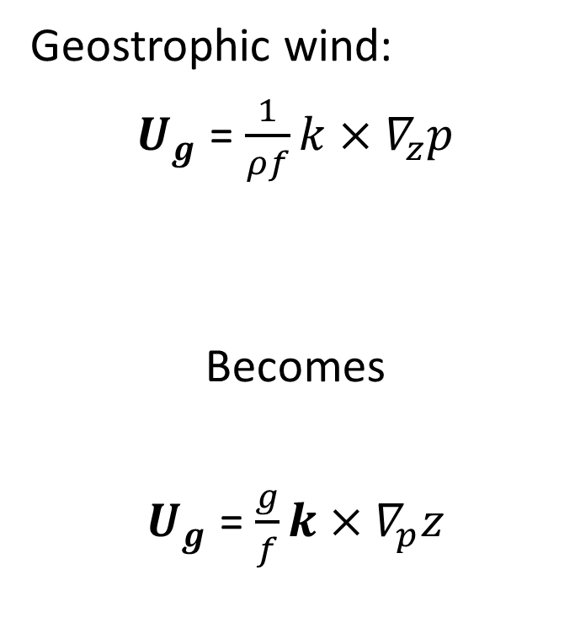
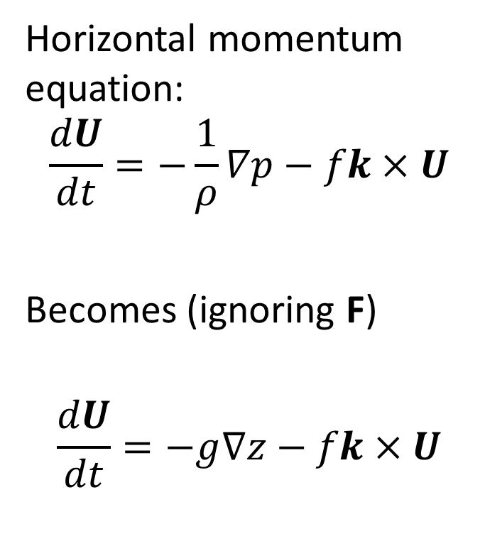
Geostrophy in pressure coordinates
Horizontal momentum equation:
$$\frac{dU}{dt}=−\frac{1}{ρ}∇p−fk×U$$
Becomes (ignoring F)
$$\frac{dU}{dt}=−g∇z−fk×U$$
Geostrophic wind:
$U_{g}$ = $\frac{1}{ρf}k×∇_{z}p$
Becomes
$U_{g}$ = $\frac{g}{f}k×∇_{p}z$

Slide 13
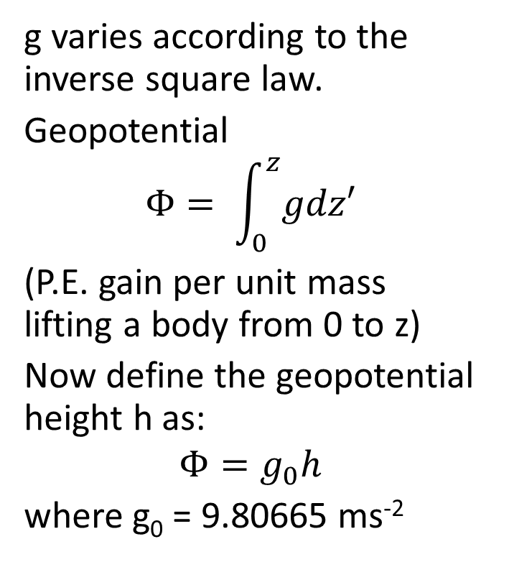
Geopotential
g varies according to the inverse square law.
Geopotential
$$Φ= \int_{0}^{z}{gdz′}$$
(P.E. gain per unit mass lifting a body from 0 to z)
Now define the geopotential height h as:
$$Φ=g_{0}h$$
where g₀ = 9.80665 ms⁻²
Since g₀∇_{p}h = ∇_{p}g₀h = ∇Φ
we can write our equations as:
$$\frac{dU}{dt}=−∇Φ−fk×U$$
and
$U_{g}$ = $\frac{1}{f}k×∇Φ$

